Slide 1
Building Scalable Infrastructure using GitOps with Terraform on GCP
HashiTalks Africa 2023

Slide 2

Basil Ndonga
Yunus Arif Said
Senior Software Engineer
Lead Software Engineer
https://www.linkedin.com/in/basil-ndonga/
https://www.linkedin.com/in/yunus-arif-said-57879351/
Notes:
Join the conversation here: http://discuss.hashicorp.com

Slide 3

What we do
iProcure is an agri-tech company that offers last mile distribution services, currently supplying agri-inputs to over 1 Million commercial smallholder farmers in East Africa
Practically speaking, it means we design, implement and operate scalable microservices to support our customers.
Notes:
Join the conversation here: http://discuss.hashicorp.com

Slide 4
Agenda
The Manual Way
Infrastructure as Code
Lessons Learned
The GitOps Way
Demo
Notes:
Join the conversation here: http://discuss.hashicorp.com

Slide 5
Imagine you want to deploy your newly created backend on the cloud.

Slide 6
Manual Way
Go to cloud console e.g GCP or AWS
Choose appropriate server, machine type, OS
Configure Networking - VPCs, Subnets, Firewalls
Spin up a database instance
Set up Secrets, TLS certificates
Spend hours on stack overflow
Configure Application
Notes:
Join the conversation here: http://discuss.hashicorp.com

Slide 7
Now imagine you want to do the same thing again. You have to replicate the same steps

Slide 8
Problems with Manual Way
Ops teams occasionally make mistakes
Releases become slow, repetitive and painful
Outages become more frequent
Notes:
Join the conversation here: http://discuss.hashicorp.com

Slide 9

Devs say “But it works on my machine”.
Test give you confidence that your infrastructure works as expected.

Slide 10
What if we told you there was an better way?

Slide 11
Infrastructure as Code
Notes:
Join the conversation here: http://discuss.hashicorp.com

Slide 12
The idea behind IaC is that, you can manage almost everything as code.

Slide 13
Servers
Databases
Load balancers
Networks
Documentation
Notes:
Join the conversation here: http://discuss.hashicorp.com

Slide 14
Tools
Terraform
Google Deployment Manager
Azure Resource Manager
AWS Cloud Formation
Pulumi
Notes:
Join the conversation here: http://discuss.hashicorp.com

Slide 15
Benefits
Code reuse
Documentation
Automation
Version Control
Collaboration
Notes:
Join the conversation here: http://discuss.hashicorp.com

Slide 16
Terraform 101
Notes:
Join the conversation here: http://discuss.hashicorp.com

Slide 17
A tool for deploying your IaC using a simple declarative language. Works with a bunch of different providers.

Slide 18
Lessons Learnt Implementing IaC
Notes:
Join the conversation here: http://discuss.hashicorp.com

Slide 19
Implement remote state
Isolate multiple environments
Create reusable modules
Test your infrastructure code
Notes:
Join the conversation here: http://discuss.hashicorp.com

Slide 20
Implement Remote State
Notes:
Join the conversation here: http://discuss.hashicorp.com

Slide 21
Terraform can find resources it previously created, as it keeps track of what resources it created on a state file

Slide 22
By default terraform uses a local backend. The state file (.tfstate) is stored in json format.

Slide 23
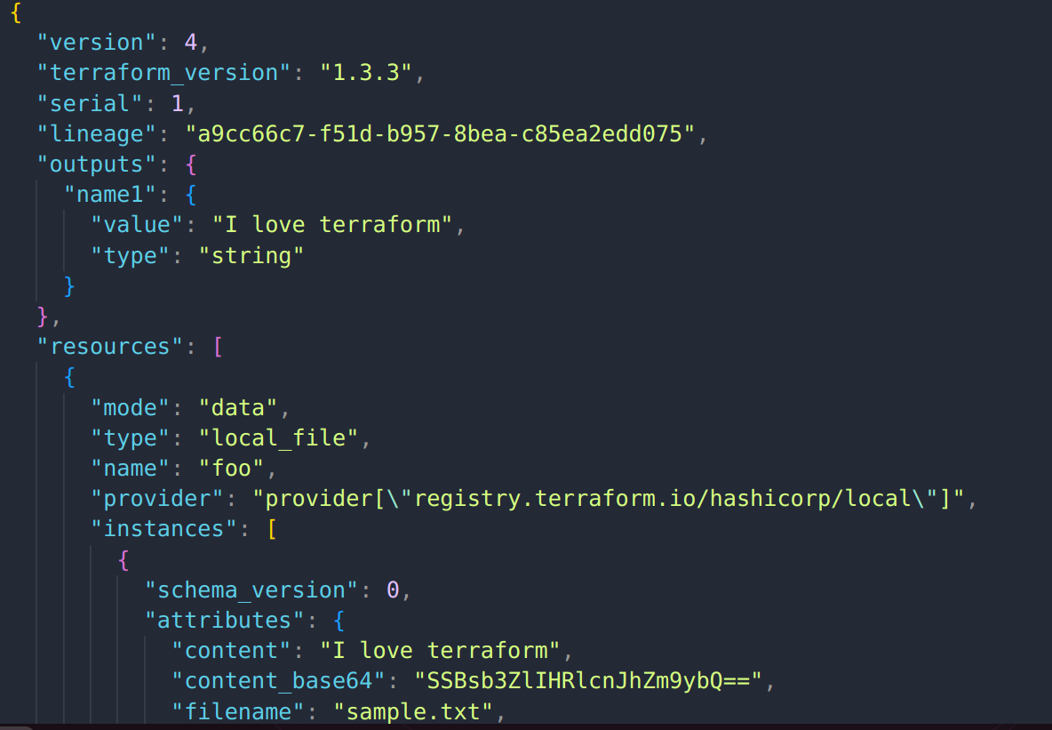

Slide 24
If you are working with teams, each member needs access to same terraform state.

Slide 25
State needs to be stored in a remote location (remote backend). State locking prevents concurrent modification.

Slide 26
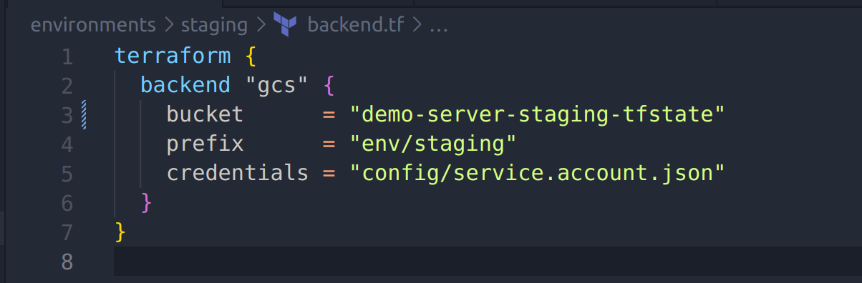
State needs to be stored in a remote location (remote backend). State locking prevents concurrent modification.

Slide 27
With remote backend enabled, terraform will now pull latest changes when running plan & apply

Slide 28
Multiple Environments
Notes:
Join the conversation here: http://discuss.hashicorp.com

Slide 29
It's a good practice to have separate environments e.g stage and prod

Slide 30
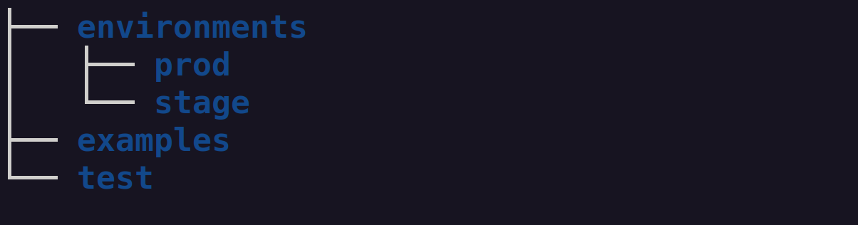

Slide 31
Reusable Modules
Notes:
Join the conversation here: http://discuss.hashicorp.com

Slide 32
Combines resources generally used together, essentially a blueprint.

Slide 33
You can now reuse the same module across multiple environments.

Slide 34
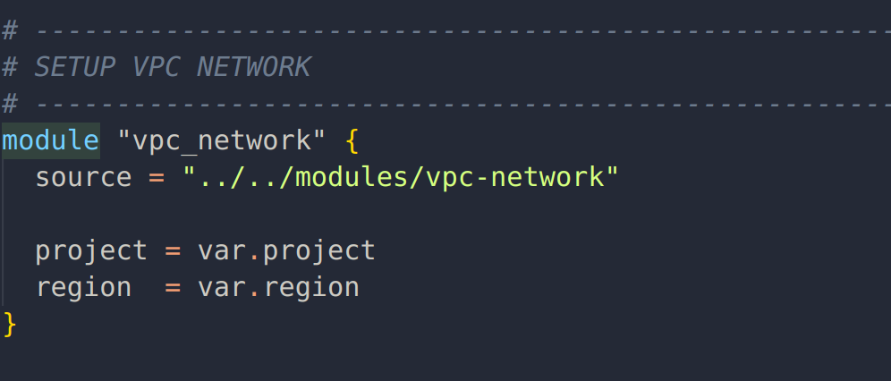

Slide 35
Module Best Practices
Place your modules in a git repository
Semantically version modules using tags
Validate module changes via code reviews
Leverage terraform module registry
Notes:
Join the conversation here: http://discuss.hashicorp.com

Slide 36
How do you unit test infrastructure code?
Notes:
Join the conversation here: http://discuss.hashicorp.com

Slide 37

Writing tests gives you confidence that your infrastructure works as expected.
Test give you confidence that your infrastructure works as expected.

Slide 38
Test Strategies
Static Analysis
Unit Tests
Notes:
Join the conversation here: http://discuss.hashicorp.com

Slide 39
Static Analysis
Notes:
Join the conversation here: http://discuss.hashicorp.com

Slide 40
Test your code without deploying it. Most basic level of testing.

Slide 41
You can use terraform plan to review changes to your infrastructure.

Slide 42
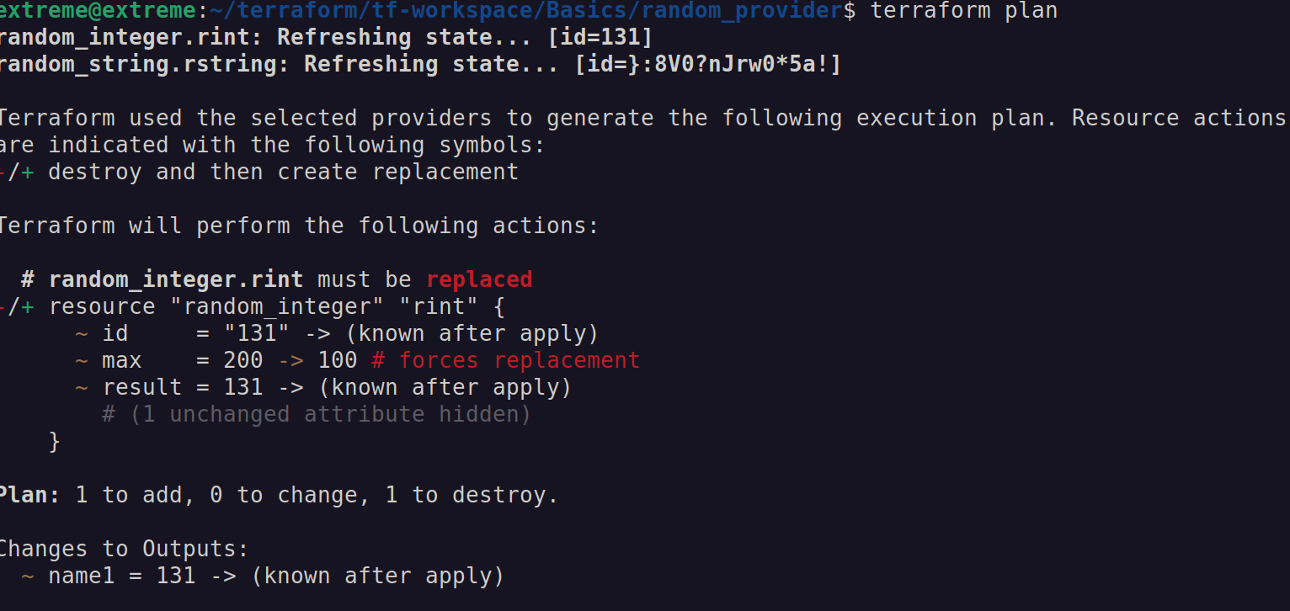

Slide 43
You can also check for syntax errors with terraform validate. Helps catch a ton of common mistakes

Slide 44
Unit Testing
Notes:
Join the conversation here: http://discuss.hashicorp.com

Slide 45
Implies testing individual modules.

Slide 46
In programming you can isolate tests from the outside environment and even mock external world.

Slide 47
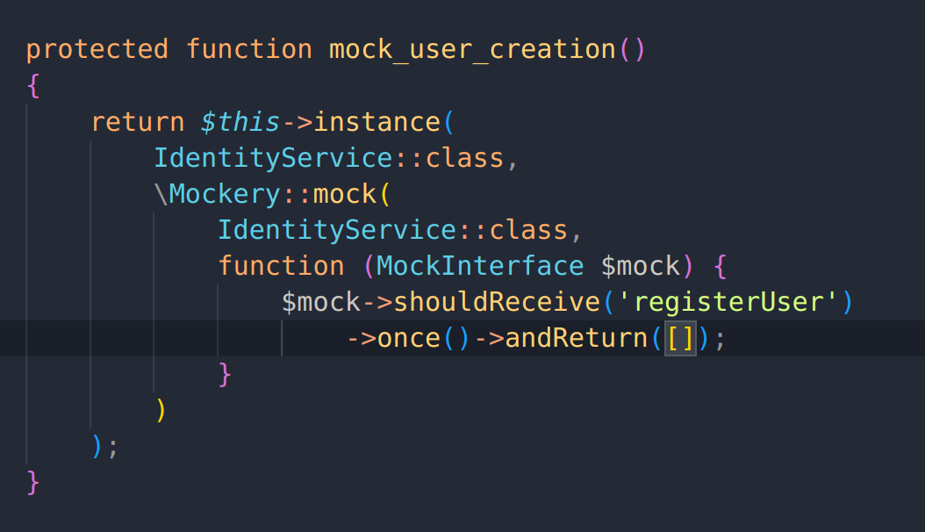

Slide 48
Infrastructure code communicates to cloud providers, essentially interacting with outside world.

Slide 49
This means deploying it to a real environment on GCP, AWS, et cetera. Best practice is to use a different project or sandbox environment.

Slide 50
Testing modules
Provision the test module
Validate that the tests pass
Destroy the infra once the test completes
Notes:
Join the conversation here: http://discuss.hashicorp.com

Slide 51
Tools
Terratest - library written in Go
Kitchen terraform
Notes:
Join the conversation here: http://discuss.hashicorp.com

Slide 52
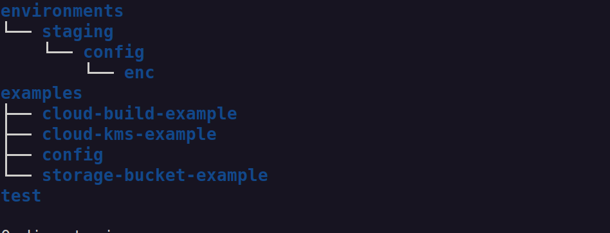
Directory Structure
This means deploying it to a real environment on AWS, GCP, Azure, et cetera.

Slide 53
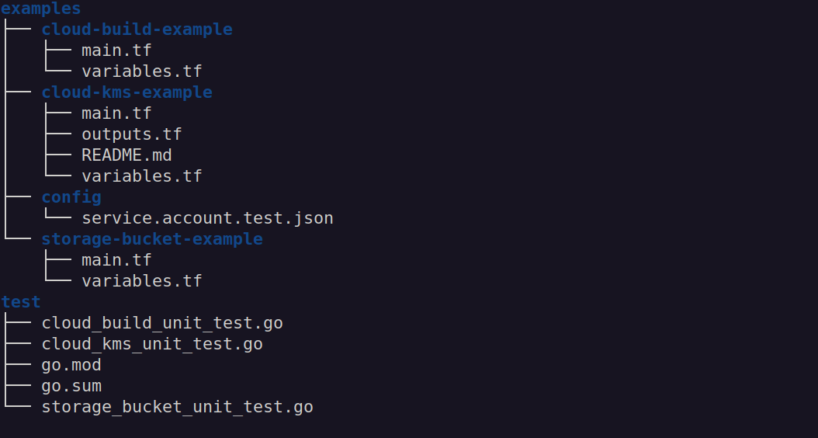
Test Directories
This means deploying it to a real environment on AWS, GCP, Azure, et cetera.

Slide 54
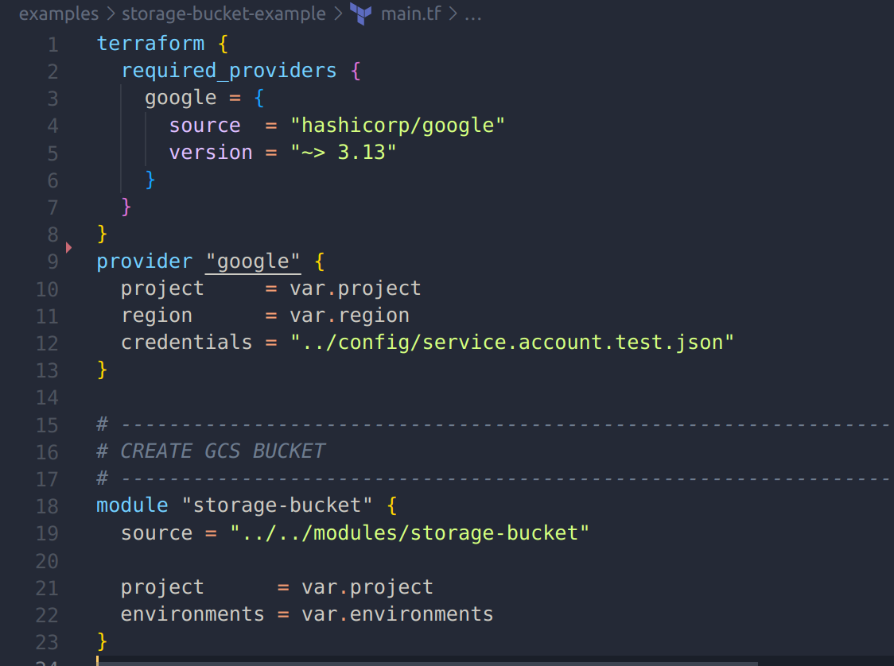
Storage Bucket Example
This means deploying it to a real environment on AWS, GCP, Azure, et cetera.

Slide 55
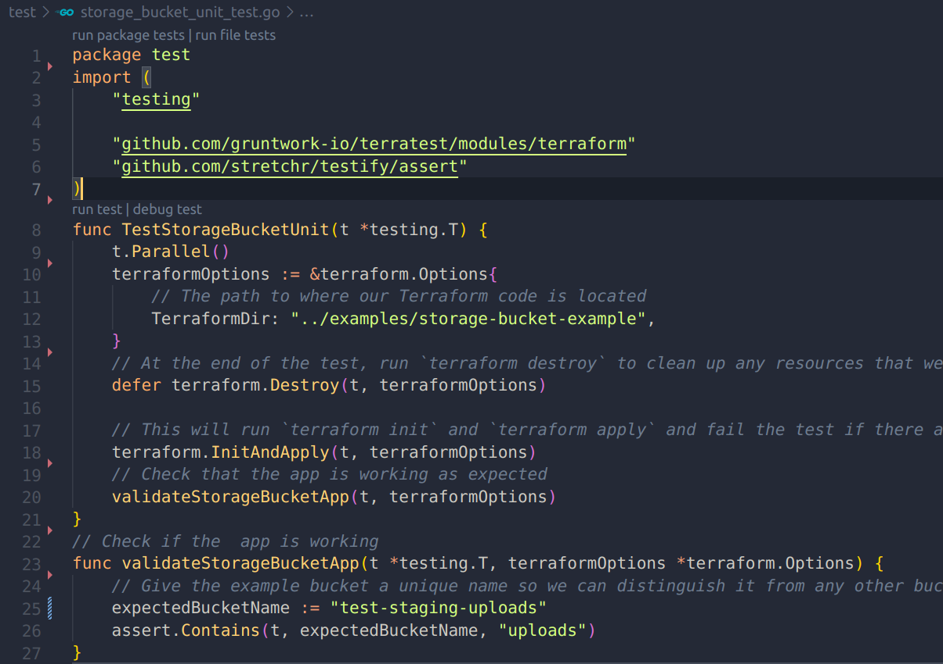
Storage bucket test.go
This means deploying it to a real environment on AWS, GCP, Azure, et cetera.

Slide 56
Run Test
$ cd test
This means deploying it to a real environment on AWS, GCP, Azure, et cetera.
$ go test -v storage_bucket_unit_test.go

Slide 57
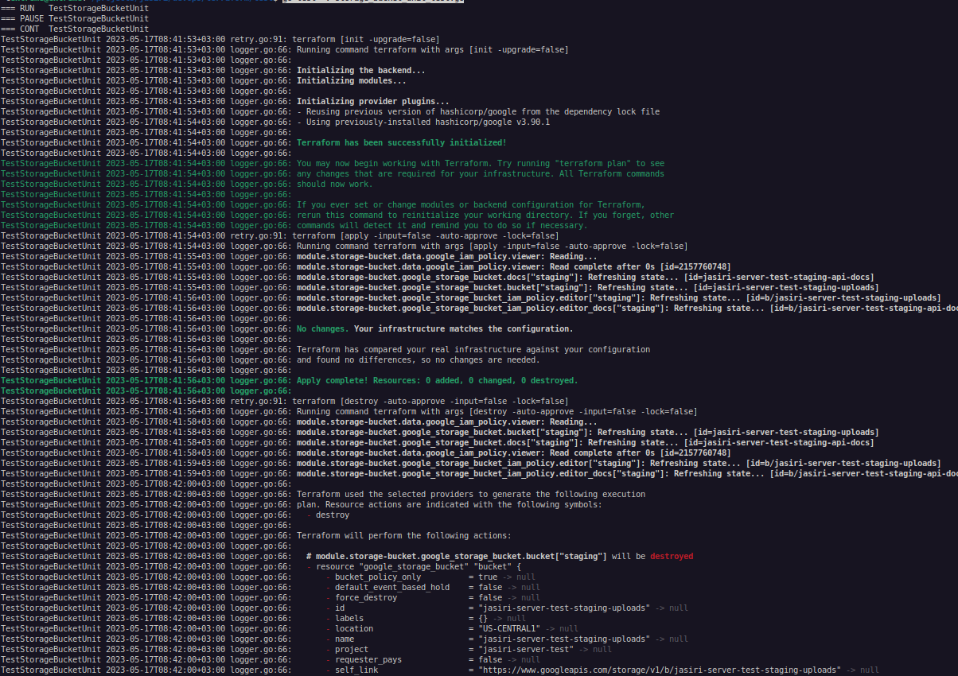

Slide 58
GitOps
Notes:
Join the conversation here: http://discuss.hashicorp.com

Slide 59
Gitops takes devops practices and applies them to infrastructure automation.

Slide 60
Infrastructure code can now be stored in Git Repositories, reviewed, merged and pushed to target environments

Slide 61
GitOps Flow
Devs push code to git repositories
Create pull request to merge to master
Triggers an automated CICD pipeline
Changes are automatically built, tested & pushed to the target infrastructure
Notes:
Join the conversation here: http://discuss.hashicorp.com

Slide 62
GitOps Benefits
Easily rollback infrastructure
Track changes to your infrastructure
Faster and more frequent deployments
Code review - only authorized members make changes to infrastructure
Notes:
Join the conversation here: http://discuss.hashicorp.com

Slide 63
Push Based Strategy
Devs make changes and push to git
Pipeline reacts and triggers a series of automated actions.
Actions updates K8s manifests and triggers changes to infrastructure.
Notes:
Join the conversation here: http://discuss.hashicorp.com

Slide 64
Build Tools
Google Cloud Build
Github Actions
Gitlab CICD
Circle CI
Notes:
Join the conversation here: http://discuss.hashicorp.com

Slide 65
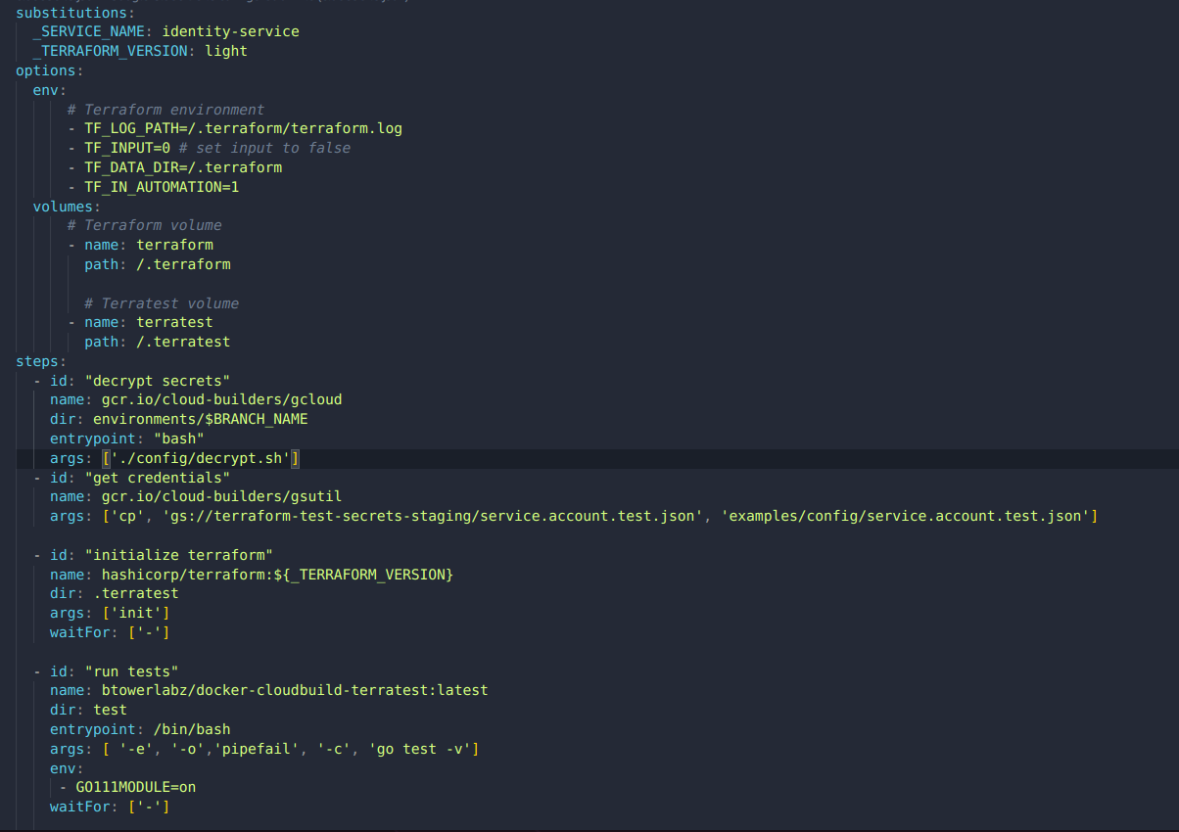

Slide 66
Demo
Deploy Infrastructure Code
Deploy sample Nest Js App
Deploy to GKE
Test application deployment
Notes:
Join the conversation here: http://discuss.hashicorp.com

Slide 67
Thank You
hugs@hashicorp.com | learn.hashicorp.com | discuss.hashicorp.com

Slide 68
Resources
Brikman Y. (2019). Terraform Up and Running, Writing Infrastructure as Code, 3rd Edition, USA, O’Reilly Media.O’Reilly Media
Github: https://github.com/Bascil/hashitalks-africa-resources.git

